Slide 1
Incident Response Information System
IRIS

Slide 2
Overview
Introduction
Design
Usecases
Demo dataset
IRIS terminology
Deep dive into IRIS

Slide 3
Introduction
Masood Sujau
Software Engineer
Previously worked for EpiSoft for 7 years.
Currently working as a consultant, developer and trainer
Email: masood.sujau@haloratech.com

Slide 4
Introduction
IRIS is a web-based secure multi-user data management and analysis platform.
Notes:
We will go into the details of each of the words next

Slide 5

Introduction
Web-based system
System is accessed using a web browser
IRIS supports all the major browsers but recommend using Google Chrome
Notes:
IRIS is a server product. It is not installed on your PC. You access it through the internet.

Slide 6
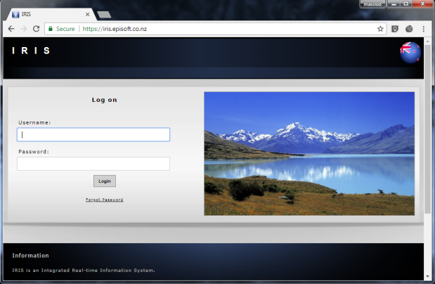
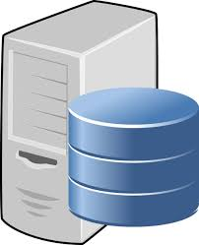

Introduction
Secure system
Encrypted connection between client and server
Requires a logon to access the system
Protects and controls data access
Notes:
Episoft hosts 2 IRIS systems a demo and a live system. The majority of Episoft’s clients are governments and they tend to host their own systems.

Slide 7





Introduction
Multi-user system
System is designed to be used by a number of people simultaneously
Notes:
You can be inputting data into the system at the same time as you colleagues and you can view each others data if the system is set up so.

Slide 8
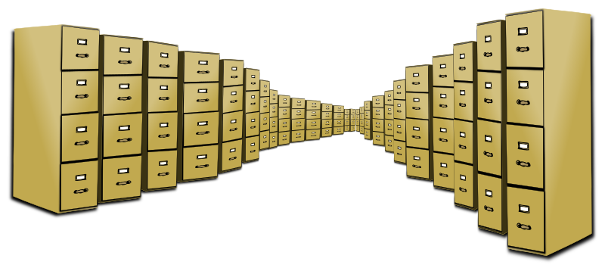
Introduction
Data management system
Data is a valuable resource
Ability to store, validate, organise, protect, deliver and enhance the value of data and information assets

Slide 9
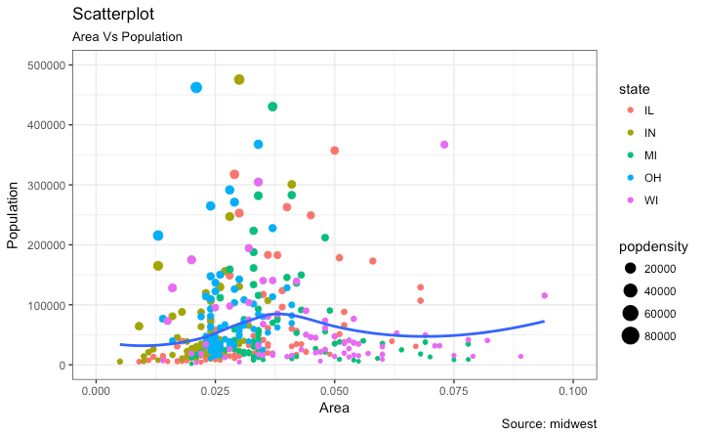
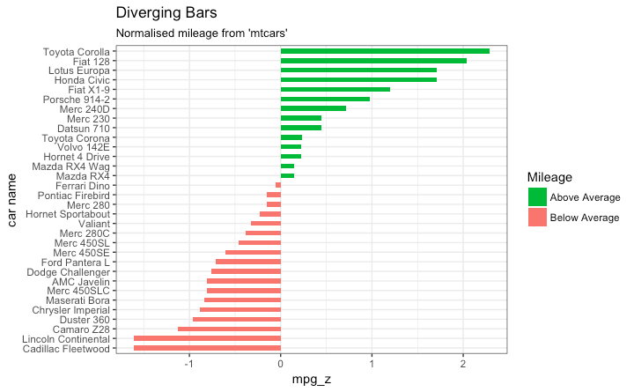
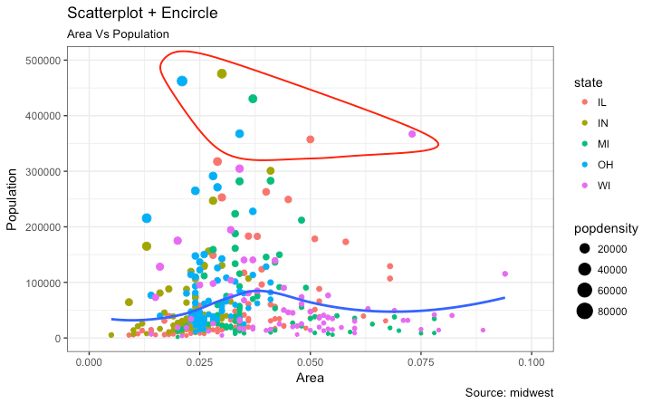
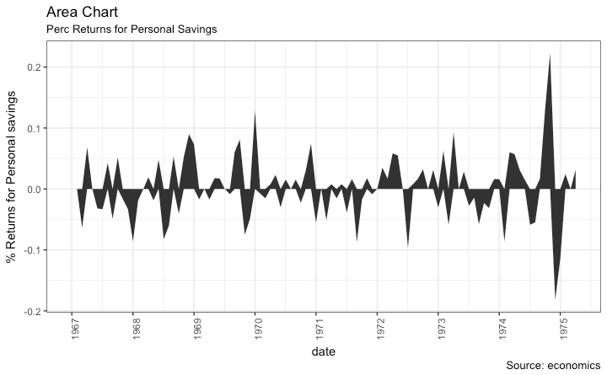
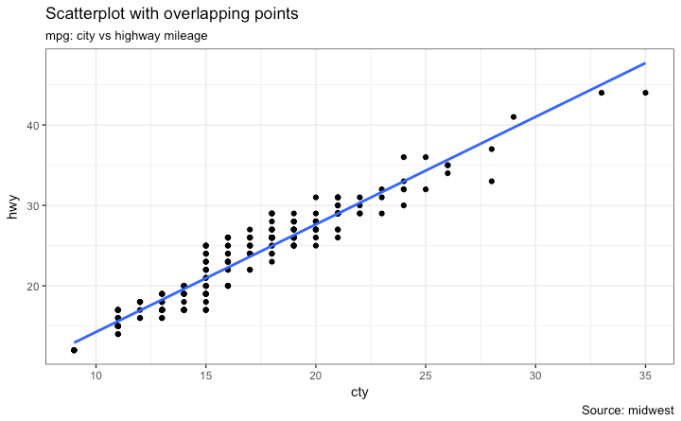
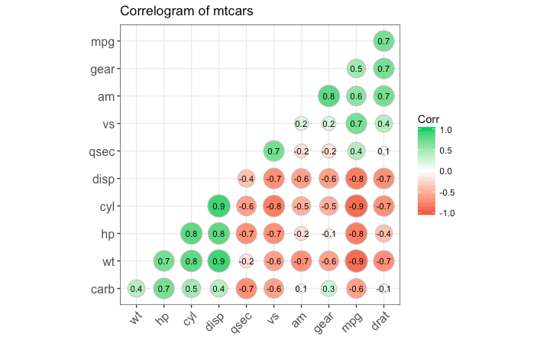
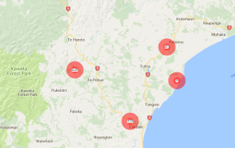
Introduction
Analysis system
Provides the means to examine, transform and visualise data with the intent of drawing conclusions, discovering useful information and supporting decision making
Notes:
IRIS has an embedded R engine. This allows for very flexible reporting.

Slide 10
Background
Custom solutions
Before IRIS Episoft gained experience from developing:
EpiMan for MAF NZ
Kodavet for Swiss Government
InfoVet (Pfizer)
Software could not evolve over time.
Hard coded rules prevented portability.
Costly to add extra features.
Notes:
All are desktop products. Issues with upgrades and installations.
Fixed roles
Software not used on a daily basis

Slide 11
Background
IRIS – Incident Response Information System
Development was funded by the European Commission through the Animal and Human Influenza Trust Fund, administered by the World Bank

Slide 12
Background
IRIS is backed by an relational database MS SQL Server
The system is based on a dynamic data storage model which allows users to modify the system to their needs over time.
All data can be geo-referenced enabling mapping and spatial analysis suited to disease control activities.
Notes:
Users can add and remove fields on the fly and rely less on IT staff.
Import data from different systems

Slide 13
Background
Data security is built into the system using role and attribute based access control.
IRIS allows the integration of data from different sources, facilitating better decision making.
Notes:
Can store spatial data and then map the data
Data can be secured row and column level by roles
Talk about current integration work

Slide 14
Background
Provides easy to use data extraction mechanisms.
Provides flexible reporting, searching and sorting of data.
Provides methods for creating and displaying help

Slide 15
Background
Backups and system updates are handled on the server side.
Integration with other systems (Support for exposing and consuming APIs)
Others benefits: scheduled tasks, remote sensing data

Slide 16
Design
Developed using industry standard tools
Client Side: ExtJS, OpenLayers
Server Side: Microsoft .NET C#
MS SQL Server (or any of the major RDBS can be used)
Spatial data stored as WKT and GeoJSON
Language independent interface
Uses RServ for reporting

Slide 17
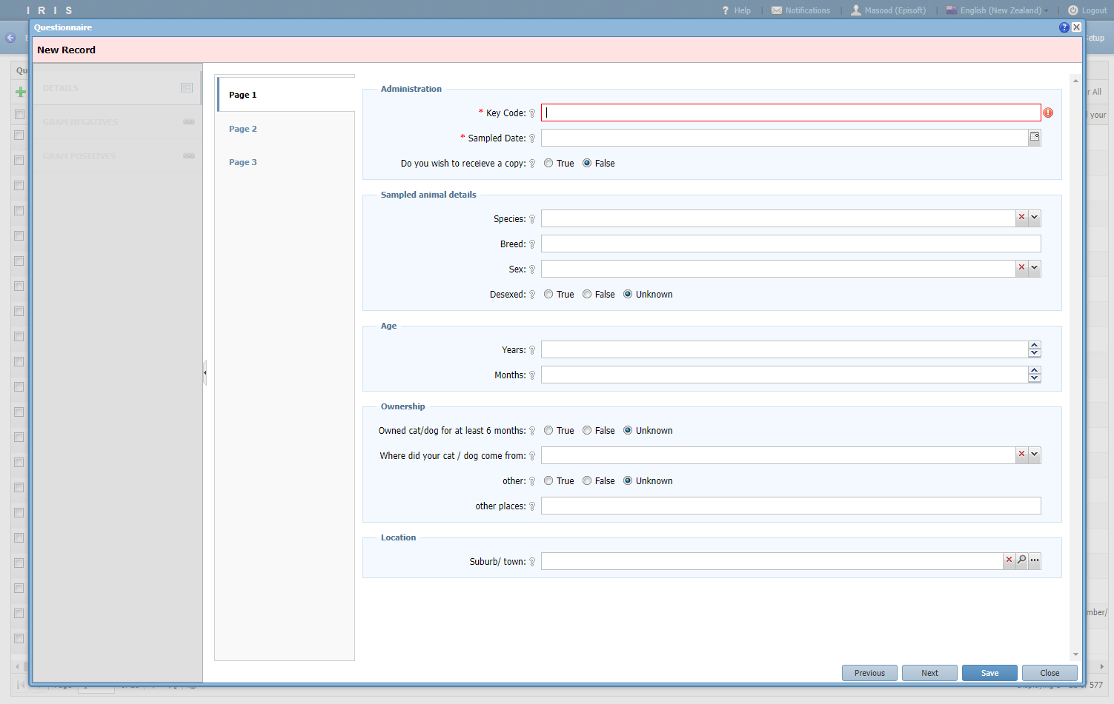
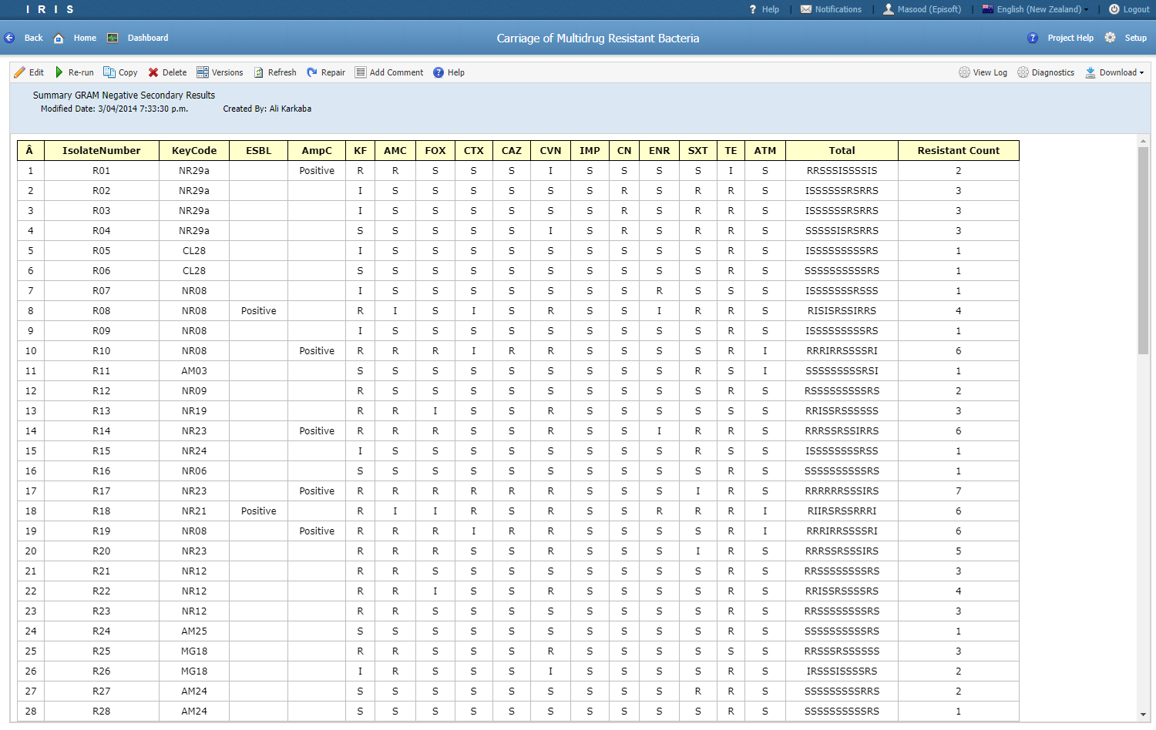
Use cases
Carriage of multidrug-resistant bacteria
IRIS was used to store the results of a survey and link the data with samples taken from cats and dogs.
The IRIS reporting engine was used to analyse the test results and create summary tables

Slide 18
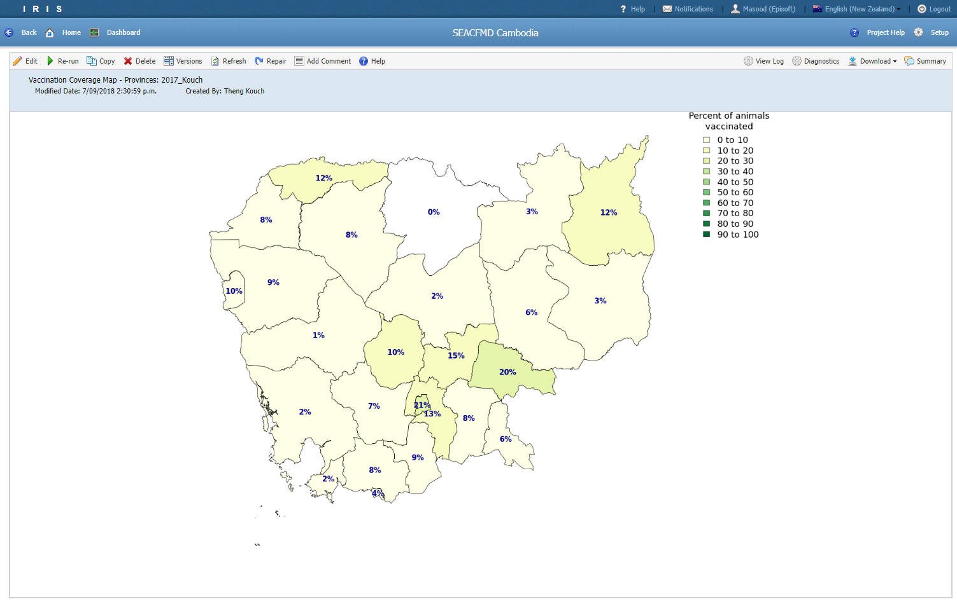
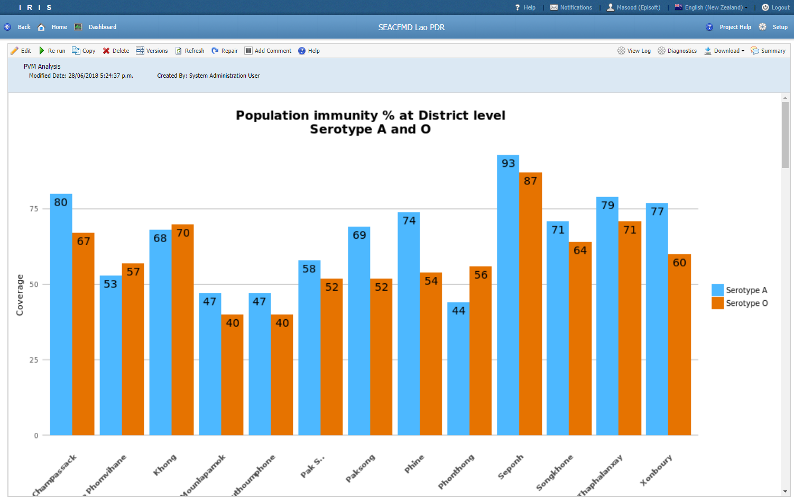
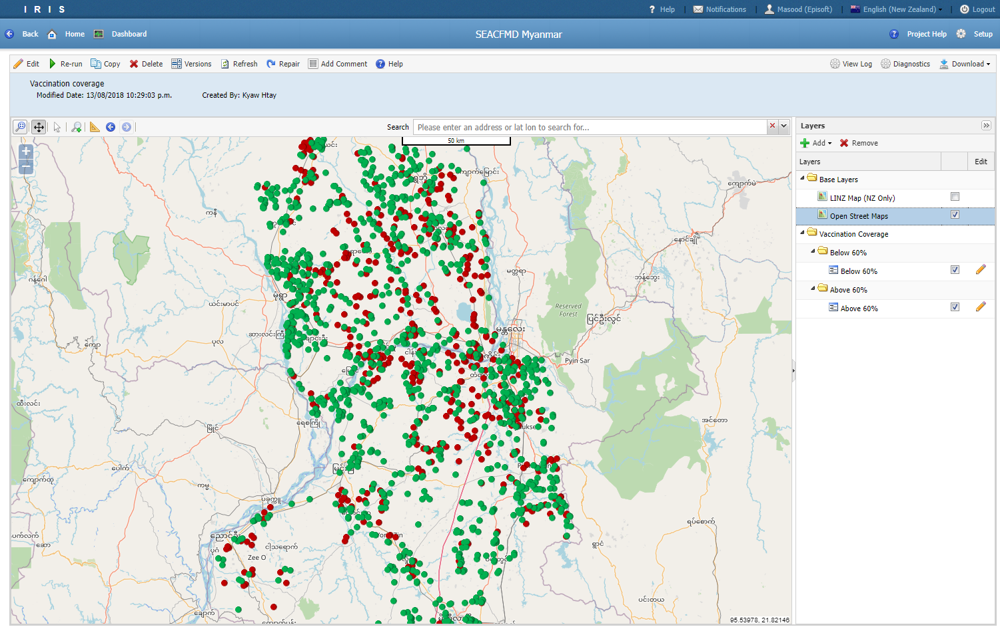
Use cases
SEACFMD Campaign
Funded by the OIE to combat foot and mouth disease (FMD) in South-East Asia and China.
IRIS was used to store survey data and results from testing and vaccination.
Helped to visual spatial coverage and trends in the data
Projects were customised to the needs of the country (Cambodia, Lao, Myanmar)

Slide 19
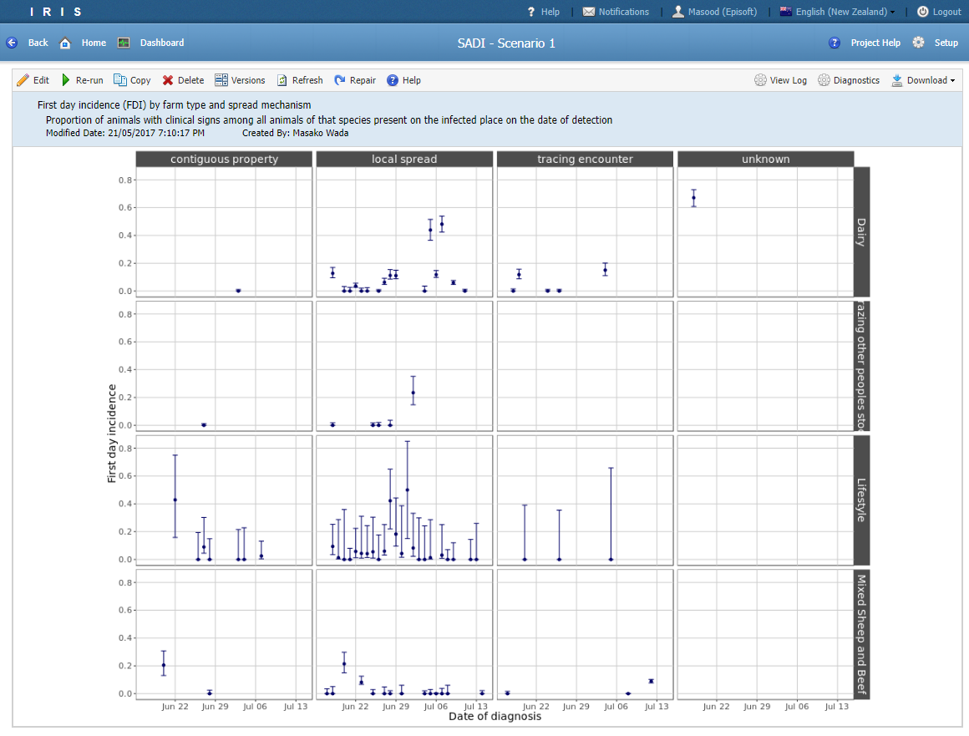
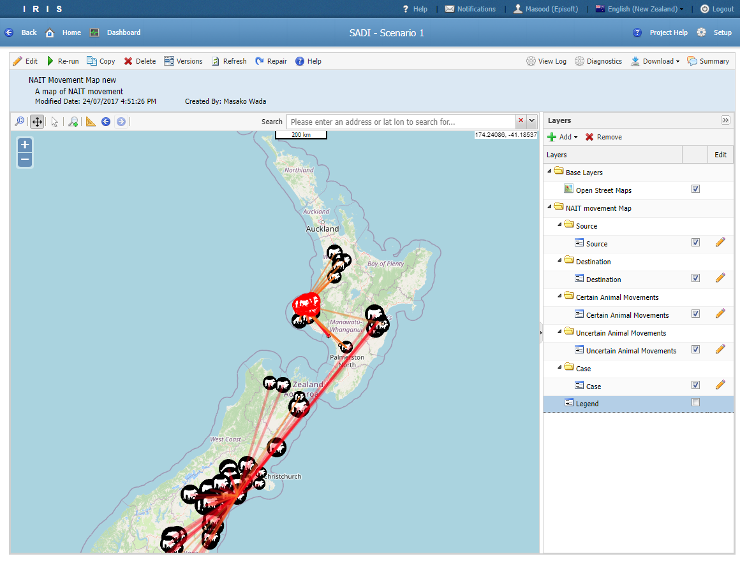
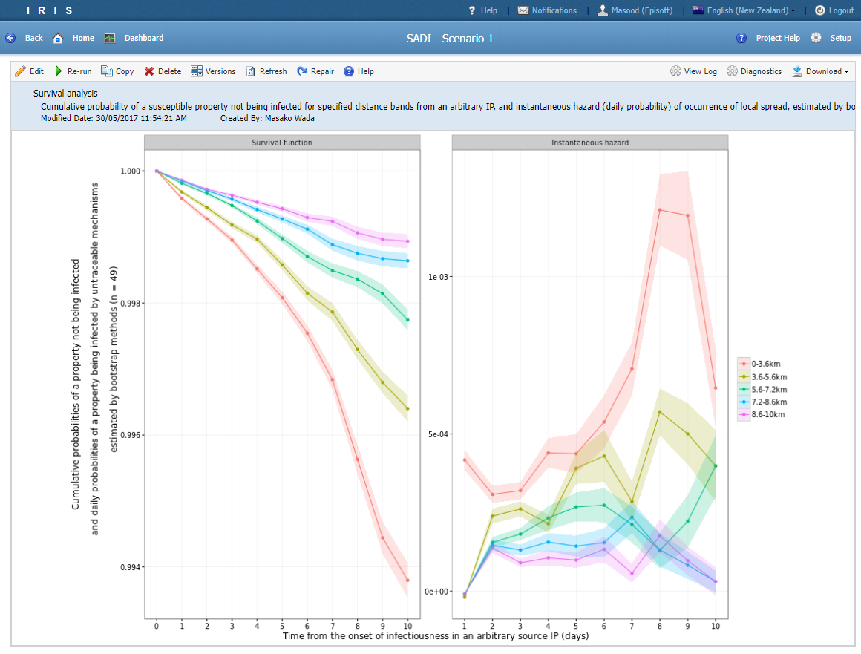
Use cases
SADI
A set of standardised analyses for disease investigation
Integrates national livestock data, outbreak data and tracing data
Enables routine analysis of up-to-date data to be run frequently
Used during the Mbovis outbreak, Korean training

Slide 20
Use cases
IRIS is known as SIMS – Surveillance Information Management System at MPI
Some of the projects in SIMS are:
Animal Health Surveillance Programme
TSE Surveillance Programme
NIMA – Notification and Investigation (Animals/Plants)
Wildlife
Mbovis SADI
Salmonella Enteritidis Response

Slide 21
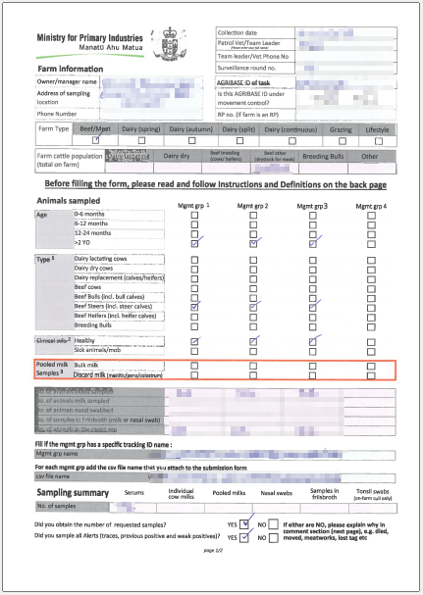
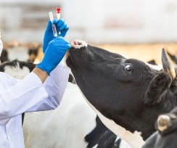
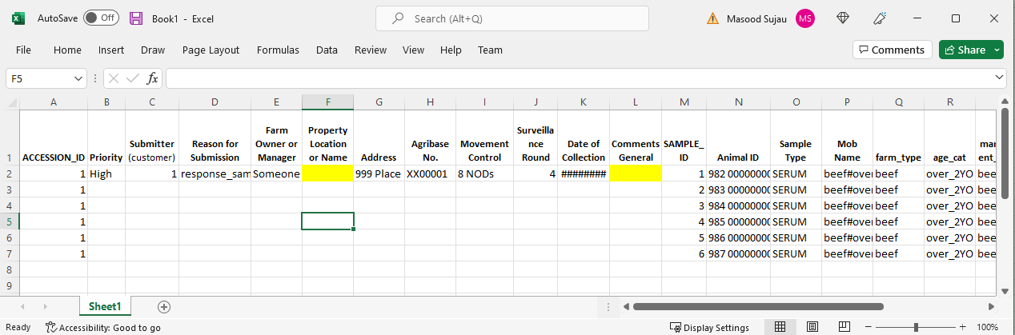

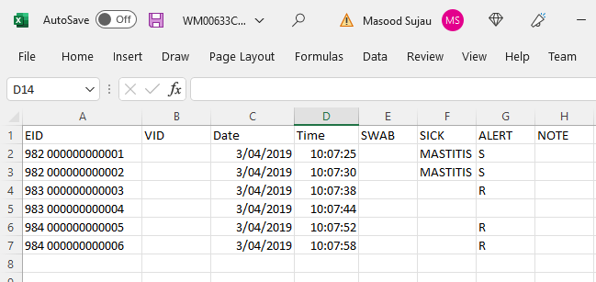
Use cases – LIMS Template
LIMS Template Project (Mbovis)
Email
Data Entry Team
Sampling Form (PDF)
Email
Wand File (CSV)
Lab

Slide 22
Use cases – LIMS Template
Issues with Excel template
Manually enter data from PDF form and wand file into excel template
Fix sample number in the excel file
Limited validation in excel
Data was stored in folders on local and shared drives
When look up values changed a new template file had to be circulated
No way to track traced or previous positive animals
Hard to search as the data was across multiple file

Slide 23
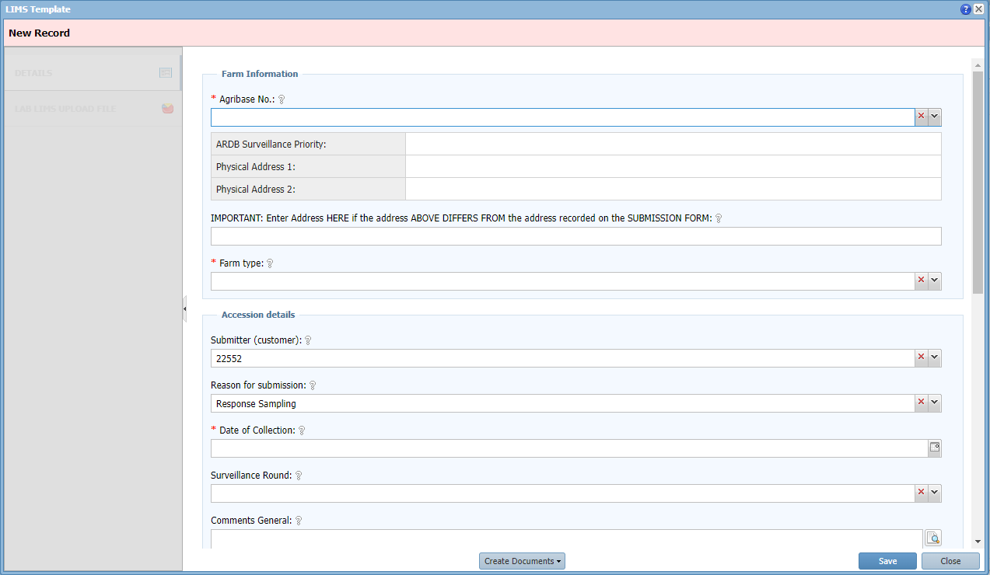
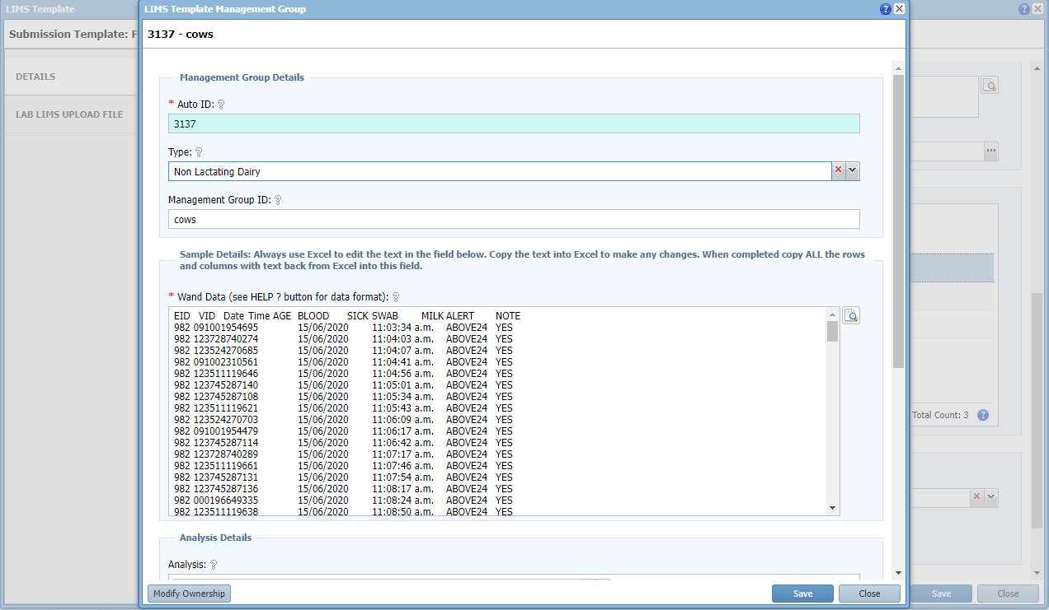
Use cases – LIMS Template
A Possible Solution
Mbovis SADI was already operational in IRIS and contained Agribase and ARDB data and was refreshed regularly
Create a separate LIMS Template project for storing farm sampling information and created a place to cut and paste wand data

Slide 24
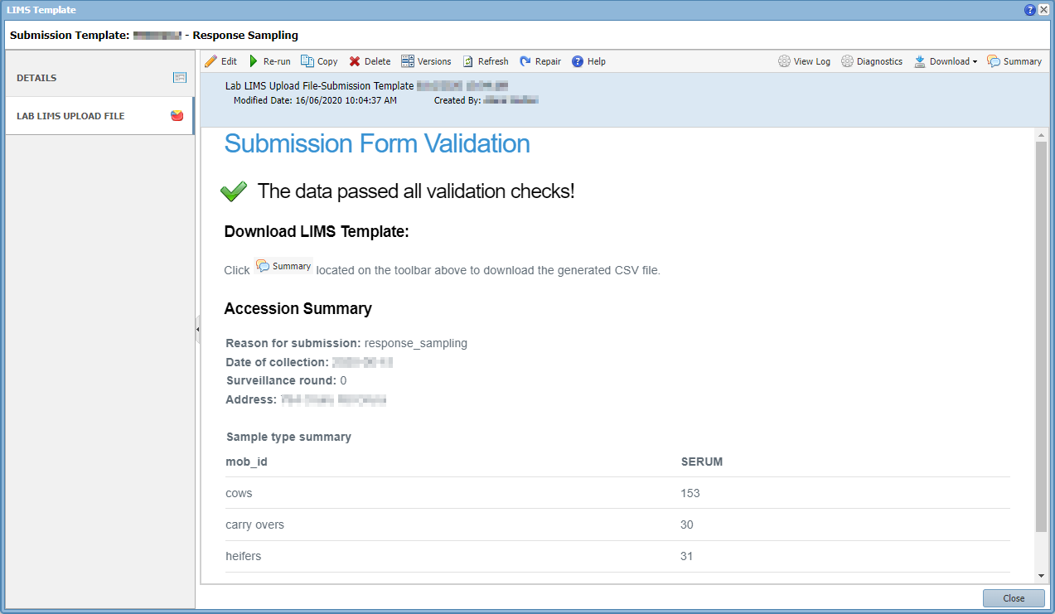
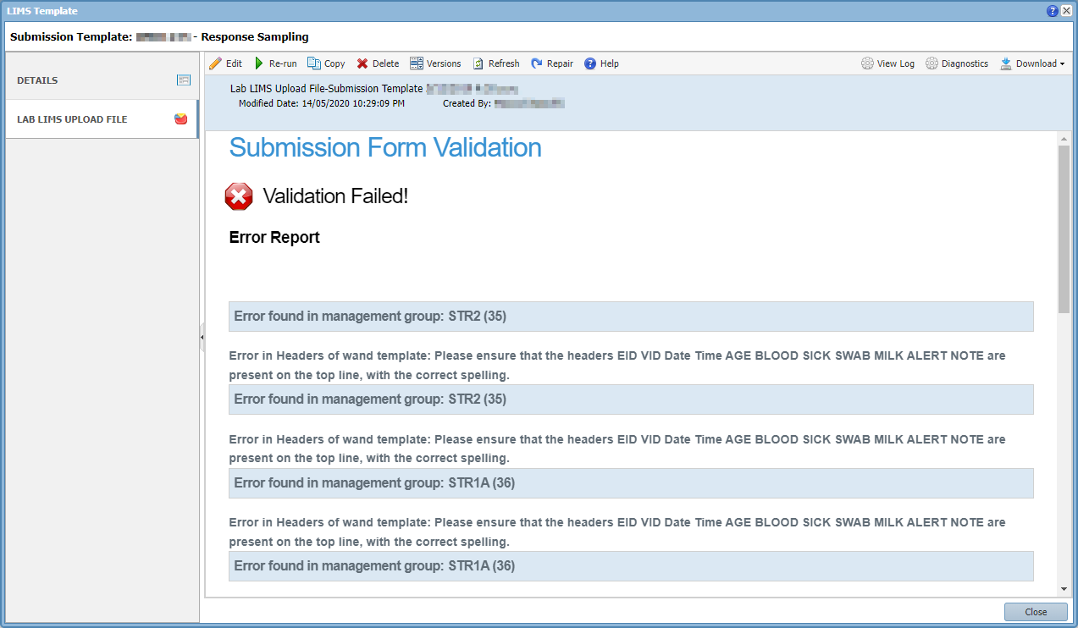
Use cases – LIMS Template
Built a report to validate the sampling information and wand data
Automated the generation of the LIMS Template file
Centralised the management of look up values
Made data entry more efficient and more accurate

Slide 25
Demo Dataset
COVID-19 dataset downloaded from MoH website on the 30th of March 2020
Consists of individual cases. 552 Confirmed and 37 probable
Contains information on
Sex | Last Country Visited
Age Group | Flight No
DHB (District Health Board) | Departure Date
Overseas Travel | Arrival Date

Slide 26
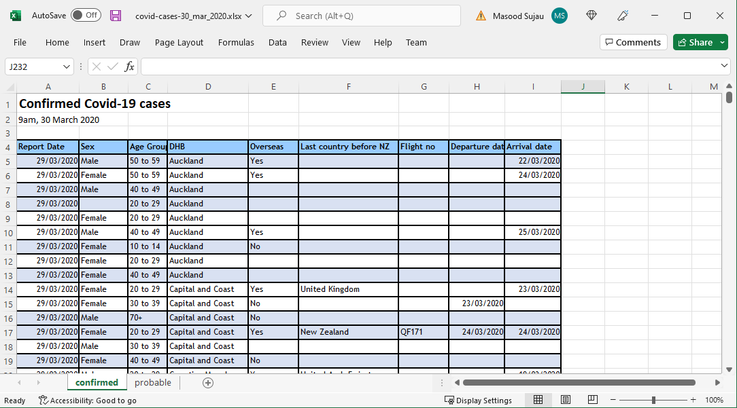
Demo Dataset
Location in GitHub Repo: /practical/data/covid-cases-30_mar_2020.xlsx

Slide 27
Quick Tour

Slide 28
Tutorial 1

Slide 29
Demo Dataset
Clean the data
Fix spelling mistakes
Consistent categories
Consistent date format (YYYY-MM-DD)
Standardise column names (remove spaces, special characters)
Combined the sheets
Added a new column called Status (confirmed/probable)
Identify repeating data (Normalise the data)

Slide 30
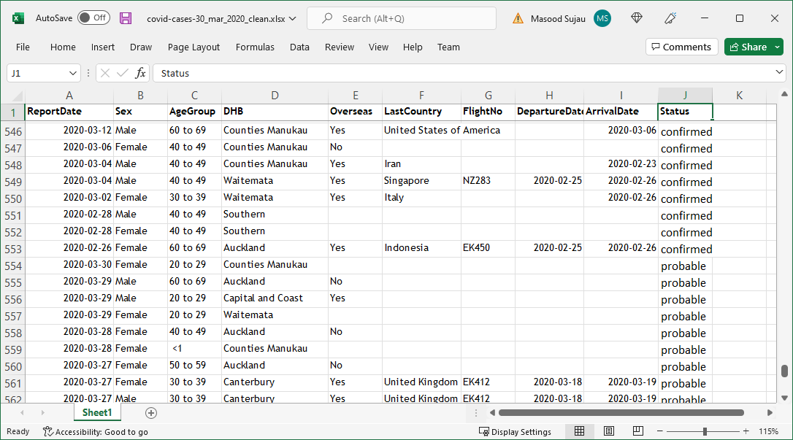
Demo Dataset

Slide 31
Demo Dataset
Sex
Female
Male
Age Group
< 1
1 to 4
5 to 9
10 to 14
. . .
Country
Argentina
Australia
Austria
Belgium
Cambodia
. . .
DHB
Auckland
Capital and Coast
Counties Manukau
MidCentral
. . .
International Travel
Yes
No
Status
Confirmed
Probable

Slide 32
Demo Dataset
Generate a model
Sex
Country
Covid-19 Case
Age Group
Status
DHB
Overseas

Slide 33
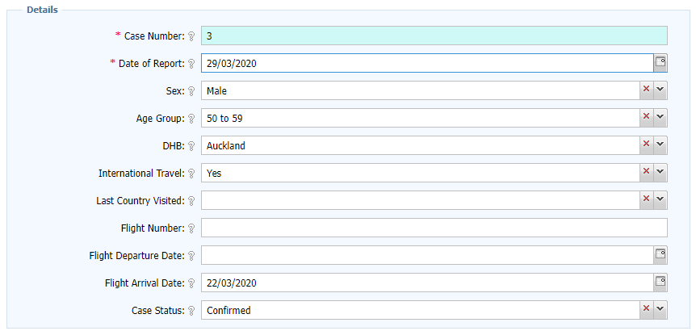
Demo Dataset
Visualise the UI

Slide 34
IRIS Terminology
Tables | A bucket to store data
Reference List | A list of look up values
Filters | View of the data across one or more tables
Report Templates | A blueprint for creating a Report using R code and any input parameters
Reports | Present data in graphic or tabular form
Roles | Grouping of users to control access to data
Labels | Grouping of Filters and Reports
Projects | Grouping of related tables, filters and reports
Domain | Grouping of Projects

Slide 35
Domains
Grouping of projects
Could be organisations or departments
Users can be in one or more domains
‘System’ is a reserved domain used for system administration
Notes:
- Similar to a single Access database

Slide 36
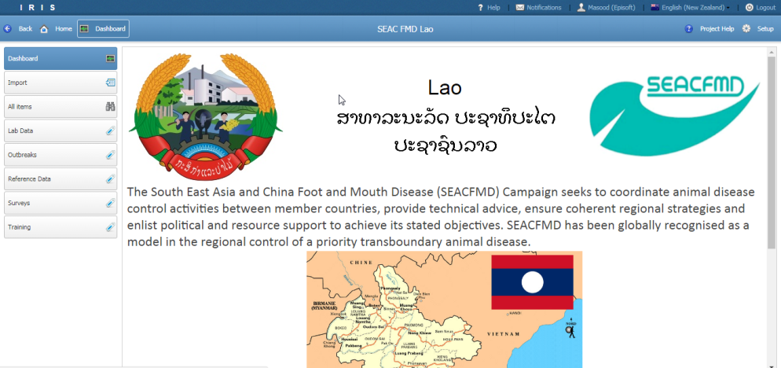
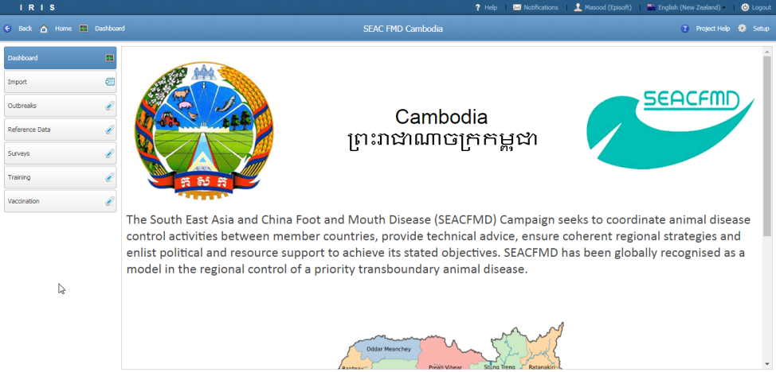
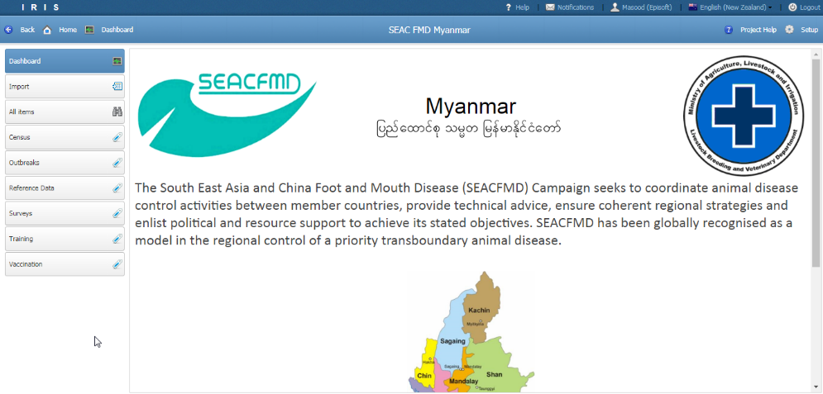
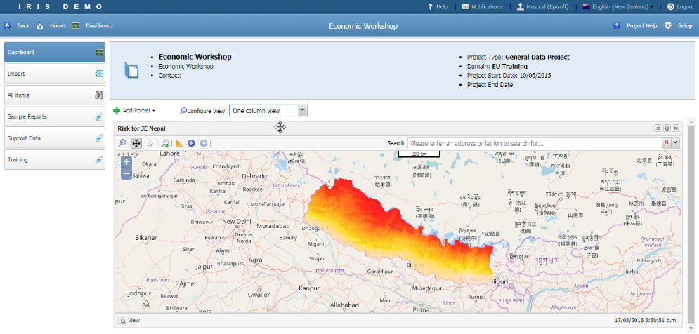
Projects
Grouping of related data
Notes:
- Similar to a single Access database

Slide 37

Projects
Setup
Import data
Labels

Slide 38
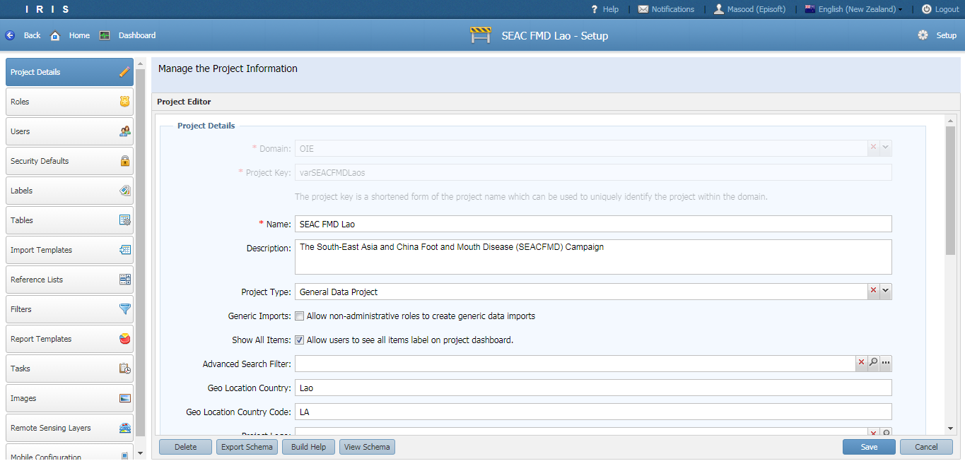
Projects - Setup

Slide 39
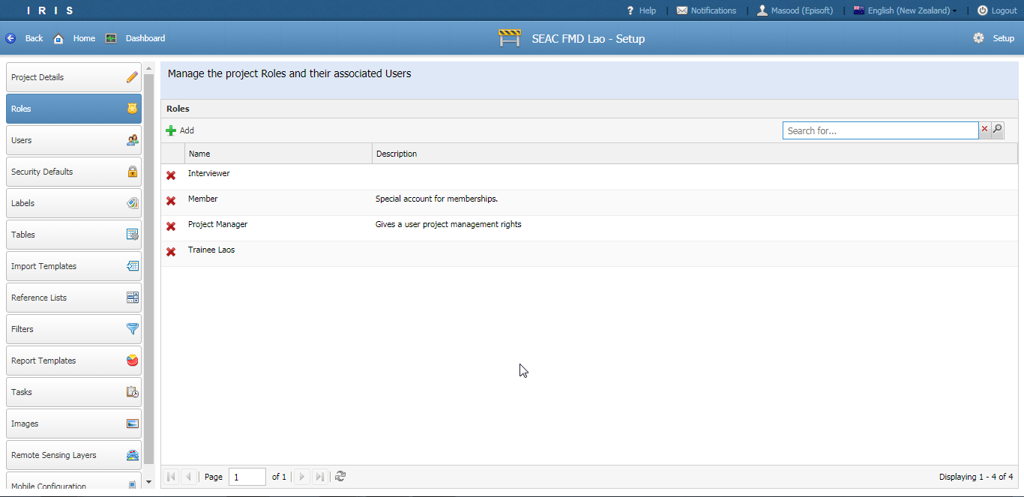
Roles

Slide 40
Roles
Roles are a method of grouping users in a project by job or function
The following roles are defined by the system and cannot be removed
System Administrator | Everyone
Domain Administrator | Domain Membership
Project Manager | Project Membership
Default User
Notes:
Other roles include: System Administrator, Domain Administrator, Domain member and Everyone

Slide 41
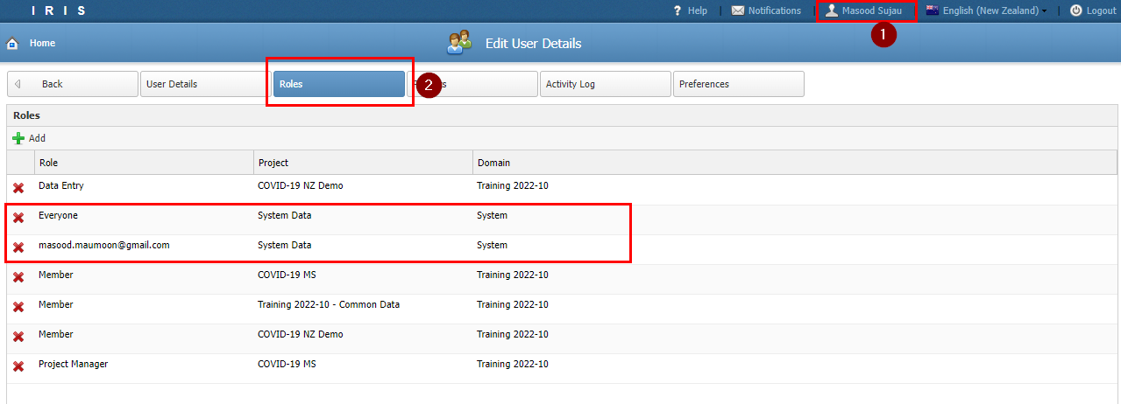
Roles

Slide 42
Roles
Custom roles can be created at both the domain and project level
E.g. Data Entry, Lab Technician, Interviewer
Good practice to think about security from the start. Identify the different types of users and their access rights
Notes:
Other roles include: System Administrator, Domain Administrator, Domain member and Everyone

Slide 43
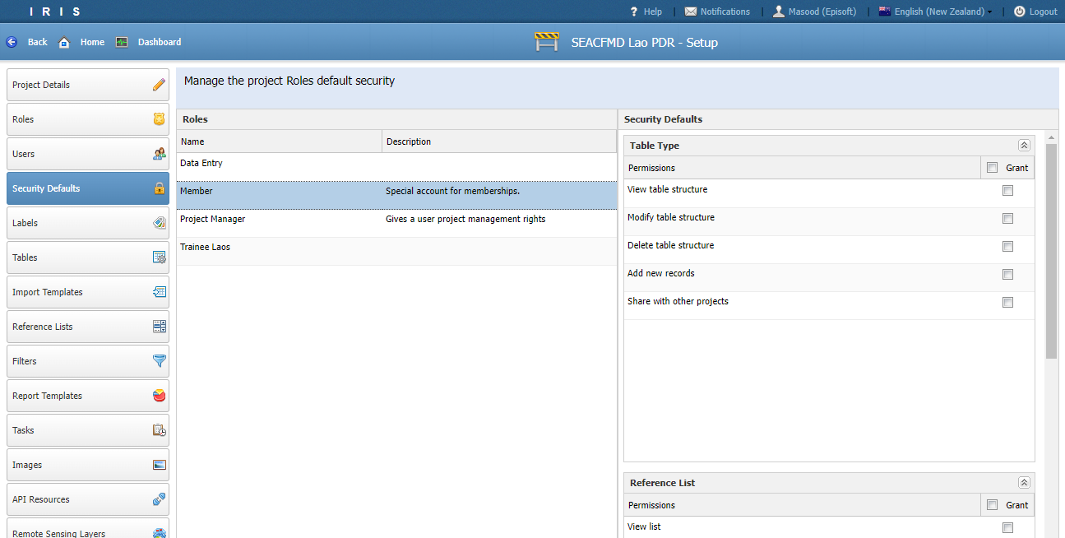
Security Defaults

Slide 44
Security Defaults
IRIS security can be divided into:
Component security
Deals with securing component structure.
E.g. A Data Entry role can not add or remove fields from table
Data security (aka “Data Policies”)
Deals with securing data inside a table
E.g. Users in the Data Entry role can add and edit rows but not delete row

Slide 45
Security Defaults
Roles are assigned permissions to secure project components.
E.g. “Interviewer” can not add fields
Project
User
Role
Permissions: Read, Update Delete
Project Component
Tables, Filters, Reference lists, Reports

Slide 46
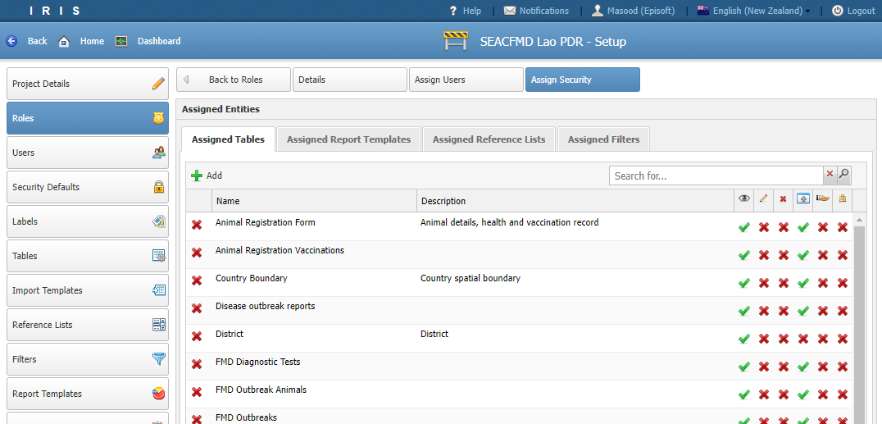
Security Defaults

Slide 47
Security Defaults
Permissions
Table
View Structure
Modify Structure (add/remove columns)
Delete Structure
Add New Records
Share
Similar permissions for reference list, filters, report templates and reports

Slide 48
Tutorial 2

Slide 49
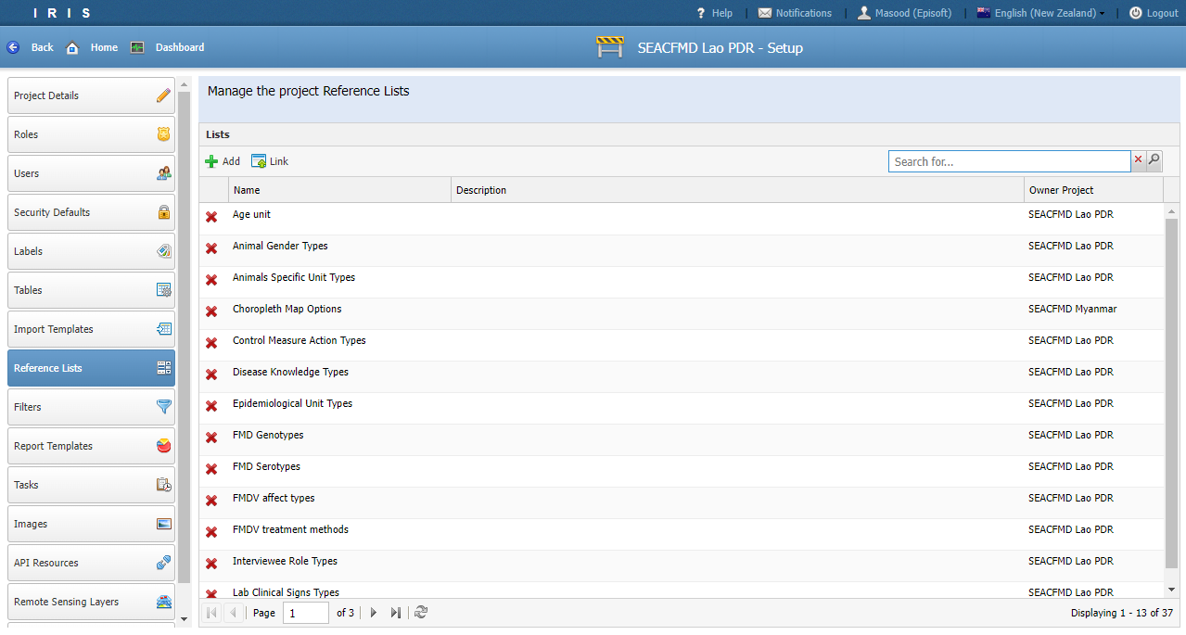
Reference Lists

Slide 50
Reference Lists
Provides an easy way to setup look up values for drop down controls
Each item in the list is a key value pair where the key is unique
The key can be used for data importing
If more attributes/fields need to be stored then opt to use a Table

Slide 51
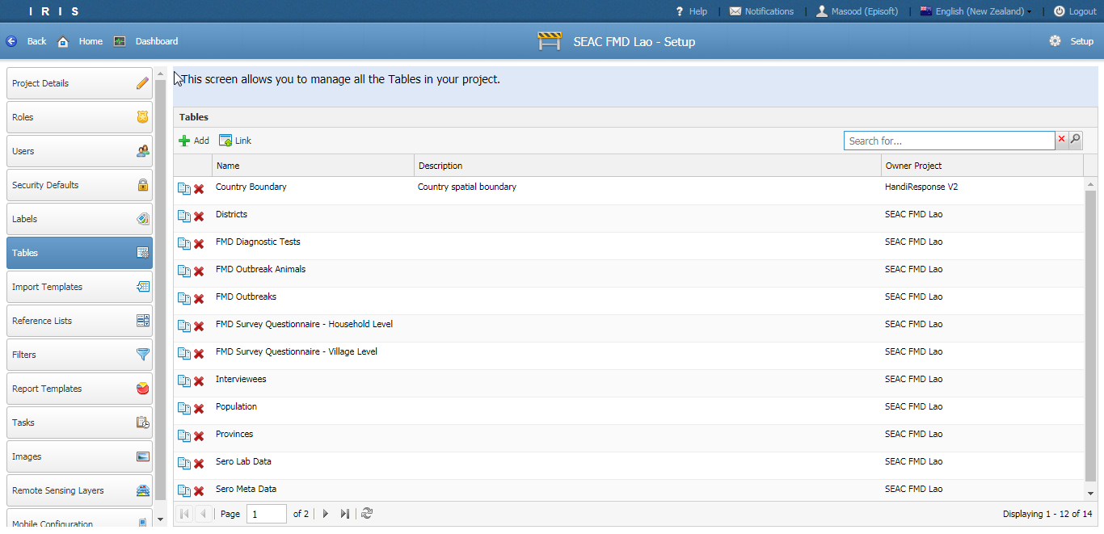
Tables

Slide 52
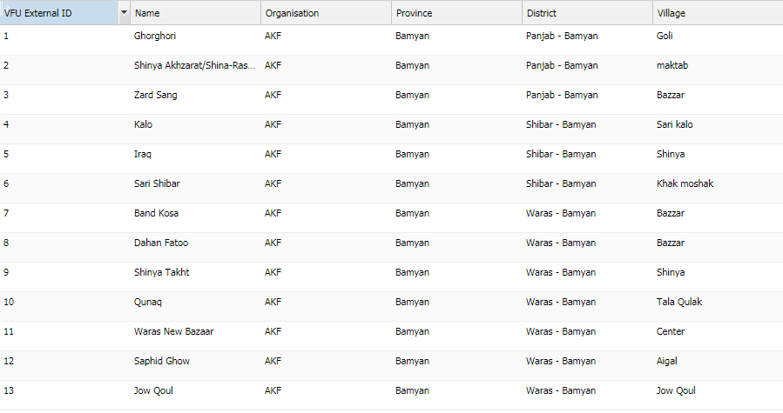
Tables
Made up of a collection records and fields
Field stores a single type of data
Records contain a collection of fields
Notes:
A table is similar to an Excel sheet
A field is like a column in an Excel sheet
Each field holds a specific type of data
You can specify rules for the type of data and formatting
A record is like a row in an Excel sheet

Slide 53
Table
Table store many different types of data. E.g. People, Animals, Places, Events etc.
Fields can be added and removed dynamically at any time.
Data can be secured at the table level, field level or row level.
IRIS generates forms from records for easier data entry
Help built into Tables and Fields

Slide 54
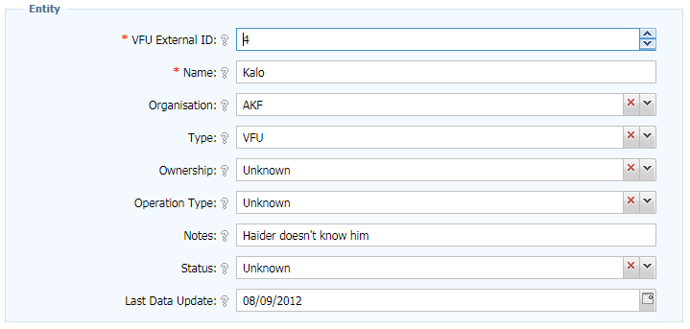
Tables
Notes:
Similar to a spreadsheet
More control over types of data that can be input

Slide 55
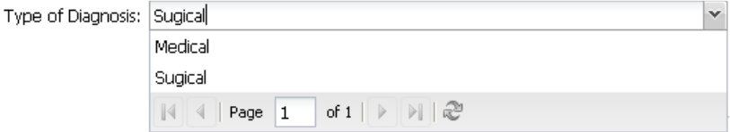
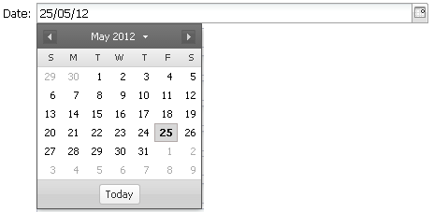
Tables - Fields
Field can be of the following types
Text
Numeric
Date and Time
Boolean (Yes/No)
Reference list (look ups)
Spatial
Relationships
Binary (Images/PDF)

Slide 56
Tables -Fields
Support validation
Required, Minimum, Maximum etc.
Assign default values
Can change the type of control to render
Control who can read, update and delete data in the field
Create help to assist data entry as tool tips or a help page

Slide 57
Tables -Fields
One unique field per table
Supported types: String, Number, Date, Auto-number
Used for data imports to do matching

Slide 58
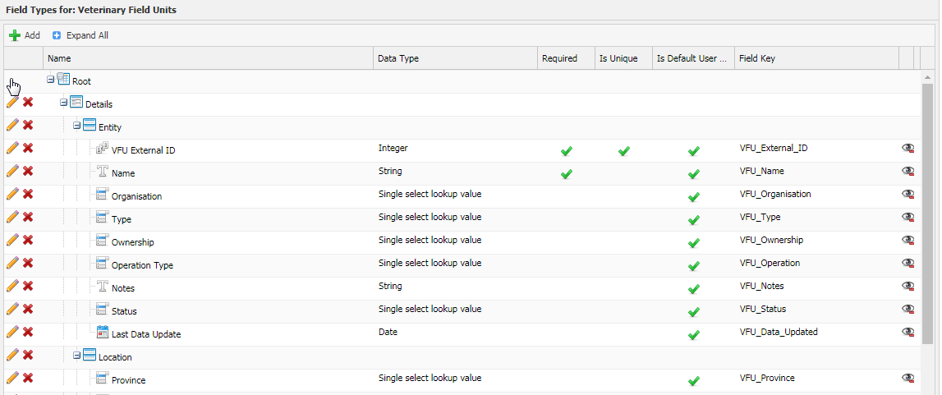
Tables – Fields
Table designer
Level 1: Forms
Level 2: Sections
Level 3: Fields
Notes:
Use the table designer to create tables
Tree of components
First level is always a “Form”
Second level is always a “Section”
Fields can be added only into “Sections”
Click the parent node to enter the type of component you want.

Slide 59
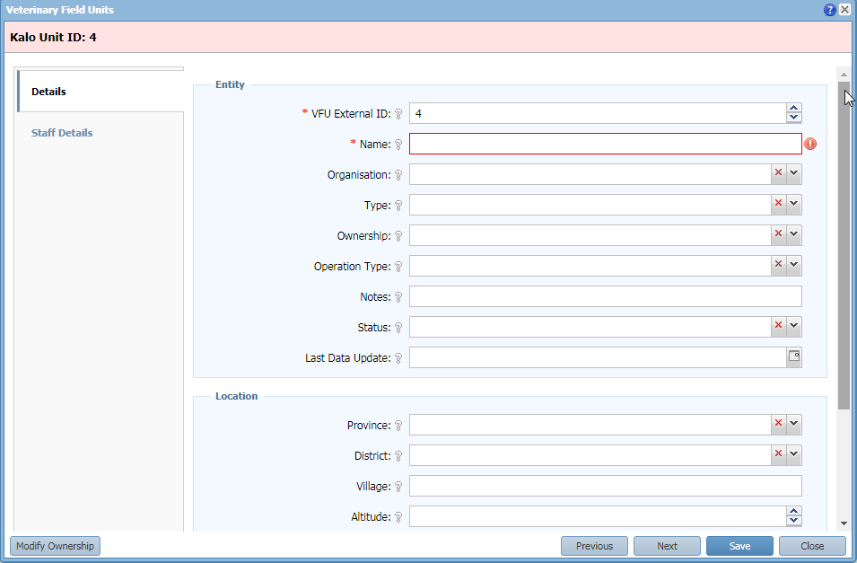
Tables – Forms
Table designer
Section
Form
Field
Notes:
Use the table designer to create tables
Tree of components
First level is always a “Form”
Second level is always a “Section”
Fields can be added only into “Sections”
Click the parent node to enter the type of component you want.

Slide 60
Tables - Relationships
IRIS Manages relationships different from relational databases
Relational databases use a primary key / foreign key relationship
In IRIS this is managed internally by it’s own reference ids
This allows IRIS to navigate the relationship forwards and backwards

Slide 61
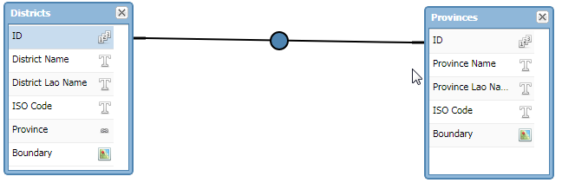
Tables - Relationships
Single relationships
When many rows from Table A (Districts) are linked to a single row in Table B (Provinces).
Also known as a many-to-one relationship.
many
one
Notes:
- To avoid repeating data, you want to create relationships between data

Slide 62
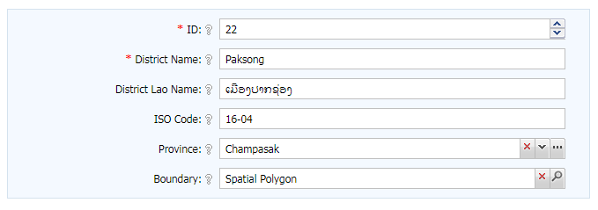
Tables - Relationships
Data is input through a dropdown list or trigger field.
Only ONE value can be picked

Slide 63
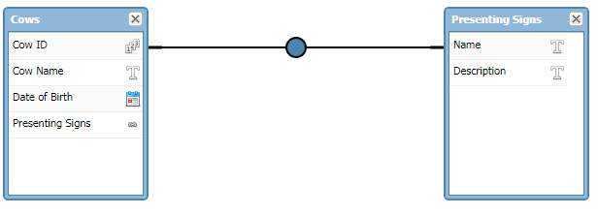
Tables - Relationships
Multi-relationships
When many rows from Table A (Cows) are linked to a many row in Table B (Presenting Signs).
Also known as a many-to-many relationship.
many
many

Slide 64
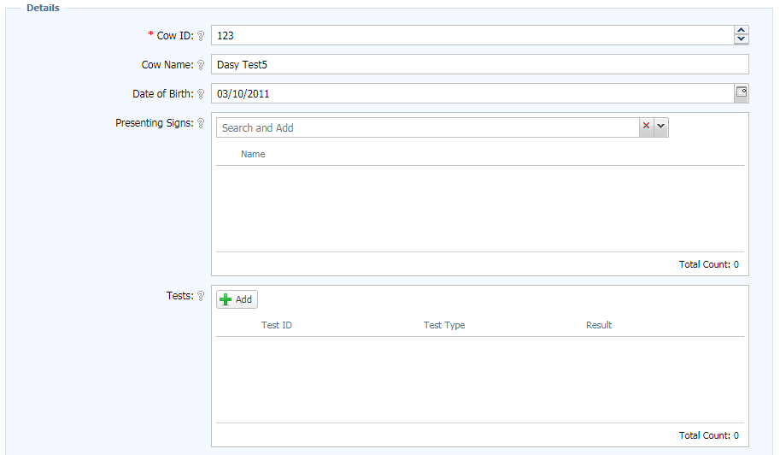
Tables - Relationships
Data is input through a list field.
MULTIPLE values can be picked or added

Slide 65

Tables - Relationships
The system automatically generates the opposite/inverse relationship

Slide 66

Table Security
Component Security and Data Policy configuration buttons are located on the bottom toolbar
Only Tables have Data Policies
Notes:
Hover to see the permission
Security needs to be well thought through

Slide 67

Table Security
Component security permission assignment.
Double click row to view field level permissions
Permissions
Notes:
Hover to see the permission
Security needs to be well thought through

Slide 68

Table Security
Data Policy Settings
Notes:
Hover to see the permission
Security needs to be well thought through

Slide 69

Table Security
Data Policy Settings
Notes:
Hover to see the permission
Security needs to be well thought through

Slide 70

Table Security
Data Policy Settings
Notes:
Hover to see the permission
Security needs to be well thought through

Slide 71
Tutorial 3 & 4

Slide 72
Importing data
Supports import from CSV, XML and JSON format
Preferred data formats
Date: yyyy-MM-dd
Date and Time: yyyy-MM-dd HH:mm:ss
Boolean: (true/false) (T/F) (1/0) (yes/no)
Reference List: Use the key
Relationships: Use the unique key
Text: Always quote the text “ “

Slide 73

Importing data

Slide 74
Importing data
Relationships need to be mapped
Related tables must have a unique column otherwise data will be appended to the end
For large imports files must be broken up into smaller chunks or could be zipped.

Slide 75
Importing data
For repeated data importing you can use an Import Template
For XML and JSON data only Import Templates are supported
Easier for end users as they only have to pick a file

Slide 76

Importing data

Slide 77

Importing data

Slide 78
Tutorial 5

Slide 79

Filters

Slide 80

Filters
A view of the data stored within one or more tables.
Notes:
It is the equivalent of a query in MS Access
Pick the Table(s) of interest
IRIS automatically creates the relationships
Pick the fields of interest
Run/Save
Additional features include aggregate functions, sorting

Slide 81

Filters
Restrictions are interpreted as AND going down and OR going across.
Evaluates to
(Gender = “Female” AND Age < 40 ) OR Age > 60
AND
OR
Notes:
It is the equivalent of a query in MS Access
Pick the Table(s) of interest
IRIS automatically creates the relationships
Pick the fields of interest
Run/Save
Additional features include aggregate functions, sorting

Slide 82
Filters
String values need to be double or single quoted.
e.g. = ‘Tom’ OR = “Thomas O’Leary”
Case insensitive search
Reference list items are considered strings – can use items key or display text and the system manages an internal reference
Dates need to be single quoted (‘)
e.g. > ‘2022-10-31’

Slide 83
Filters
Support for passing parameters
e.g. = [farm_no]
Reserve words
TRUE | True value
FALSE | False value
NULL | Null value
[USER_ID] | Returns the current user’s ID

Slide 84
Filters
Operations on numeric columns
e.g. > 24 * 7
Operations date columns
e.g. < DATEADD(-5, NOW())
Operations on text based columns - begins(), ends() contains()
e.g. BEGINS(“Spe”)
Support for IN clause
e.g. IN (“fever”, “chills”)

Slide 85

Filters
Additional metadata can be accessed through the Advanced button
Create Date, Modified Date, Owning User ID etc.

Slide 86
Filters
Function | Details | Data Types
Sum | Adding all the data | Integer, Double
Average | Averaging the data | Integer, Double
Min | Minimum value | Integer, Double, Date
Max | Maximum value | Integer, Double, Date
Count | Count the number of occurrences | Integer, Double, Date, String
Concatenate | Join the values by string | String

Slide 87

Filters
Running a filter produces a grid of data
Toolbar
Search
Spatial field

Slide 88

Filters - Maps
If a spatial column is present then the data can be mapped.

Slide 89

Filters - Search
Google type search vs parameter search

Slide 90
Tutorial 6

Slide 91
Labels
Labels

Slide 92
Labels
Labels provide a menu system to navigate a project
Keep related filters and reports under the same label
If only one item is under a label then the system navigates straight to that item

Slide 93

Labels

Slide 94
Tutorial 7

Slide 95

Report Templates & Reports

Slide 96
Report Templates & Reports
A report template executes R Code with some input parameters to produce a Report.
End users will only need to provide the input parameters or simply re-run a report
The parameters depend on the type of Report Template.

Slide 97



Report Templates & Reports
Report outputs can be:
Image
KML
Text file
HTML

Slide 98

Report Templates & Reports
Report Templates
Reports

Slide 99
Report Templates & Reports
The IRIS reporting engine gathers all the parameter values required by the R code defined in a Report Template
Parameters could be
User input fields
Filters
Http request
Images
Reference Lists

Slide 100
Report Templates & Reports
The engine then generate an executable R script with security overrides and creates a zip package
The zip file gets sent to a Linux server running Rserv (A web server built for running R)
Rserv excutes the script and packages up all the results and sends it back to the reporting engine.

Slide 101
Report Templates & Reports
The reporting engine extracts the results and displays the output according to the type of media

Slide 102


Dashboard
Dashboard can be presented with portlets or a static HTML page

Slide 103
Dashboard
Portlets allow you to present reports and filters as mini windows on the dashboard
There is no limit to the number of portlets – but having too many may increase load time

Slide 104

Dashboard
You can configure a static HTML page as the dashboard from the Project settings

Slide 105

Dashboard
Pages can be targeted to specific roles and language.
Provides a WYSIWYG ("What You See Is What You Get") type HTML editor

Slide 106
Questions?
Contacts
http://wiki.episoft.co.nz
masood.sujau@haloratech.com
bryan@episoft.co.nz

